Slide 1
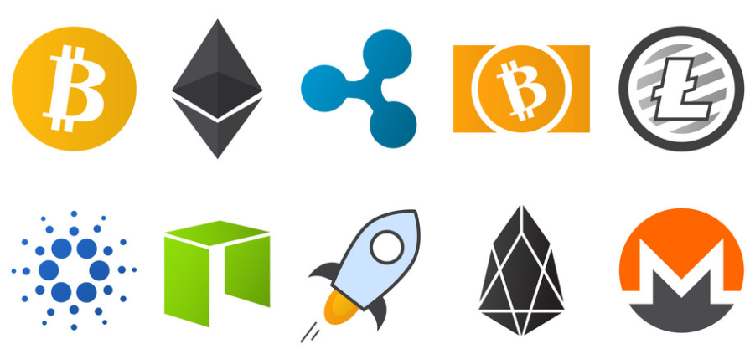
Fungible Tokens
Loke KS

Slide 2
Tokens
Ethereum is a platform that can be used to create any arbitrary smart contract including smart contracts that represent digital assets called Ethereum tokens.
They are digital assets which are not the main currency of that blockchain.
Ethereum tokens can represent anything from a physical object like gold (Digix) to a native currency used to pay transaction fees (Golem).
Tokens may even be used to represent financial instruments like stocks and bonds.

Slide 3
What is a Token?
Tokens can represent virtually anything in Ethereum:
reputation points in an online platform
skills of a character in a game
lottery tickets
financial assets like a share in a company
assets (e.g. gold, silver)
a fiat currency like USD
token-based voting systems
currencies for decentralized apps
staking platforms

Slide 4
Tokens
A token is a representation of something in the blockchain. This something can be money, time, services, shares in a company, a virtual pet, anything.
By representing things as tokens, we can allow smart contracts to interact with them, exchange them, create or destroy them
Tokens can be Fungible, Non-fungible, and Semi-fungible.
Tokens are programmable digital units of value that are recorded on a distributed ledger protocol such as a blockchain

Slide 5
Tokens
Ethereum tokens are special forms of smart contracts that utilise the Ethereum blockchain, rather than having their own blockchain like Bitcoin.
The properties and functions of each token are entirely subject to its intended use.
Tokens can have a fixed supply, constant inflation rate, or even a supply determined by a sophisticated monetary policy.
Tokens can be used for a variety of purposes such as paying to access a network or for decentralized governance over an organization.

Slide 6
Tokens
Plenty of well-known digital currencies use the ERC-20 standard, including :
Maker (MKR)
Basic Attention Token (BAT)
Tether USD
BNB
Uniswap
There are a total of 400,000 over token contracts on Ethereum.
If you are planning on purchasing any digital currency that's issued as an Ethereum token, you must also have a wallet that is compatible with these tokens

Slide 7
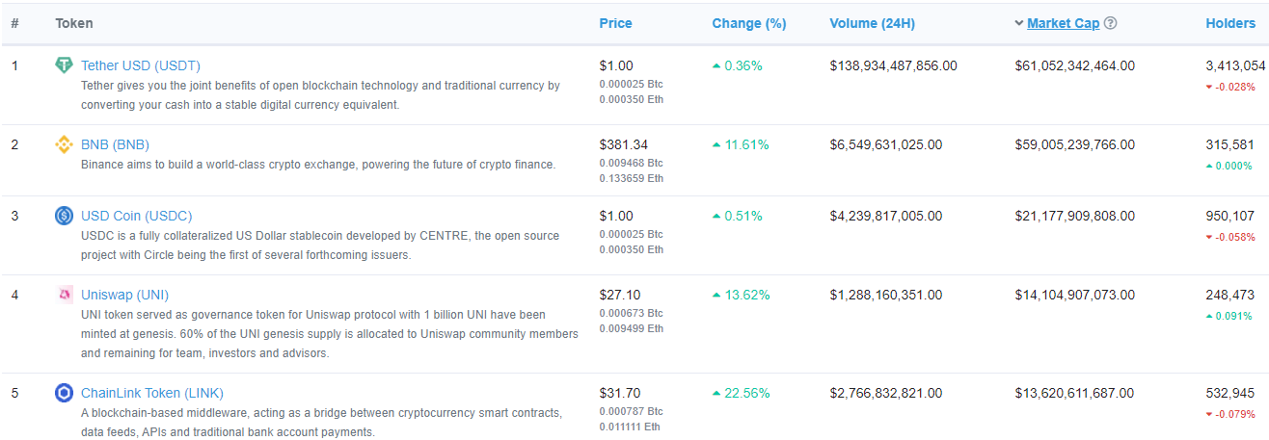
Tokens
https://etherscan.io/tokens

Slide 8
Fungible and non-fungible
Fungible goods are equivalent and interchangeable, like Ether, fiat currencies, and voting rights. Non-fungible goods are unique and distinct, like deeds of ownership, or collectibles.
In a nutshell, when dealing with non-fungibles (like your house) you care about which ones you have, while in fungible assets (like your bank account statement) what matters is how much you have.

Slide 9
Types of Tokens
Fungible tokens are tokens are that indistinguishable from each other. Example, currency coins are indistinguishable from each other.
Non fungible tokens (NFT) are each unique: each one can have a different value and they are not interchangeable.
NFTs enable the tokenization of individual assets. NFTs can be used to represent items such as photos, videos, audio, and other types of digital files.
Multi tokens – mixture of fungible and non fungible

Slide 10
Token Standards
Because everything in Ethereum is just a smart contract, and there are no rules about what smart contracts have to do, the community has developed a variety of standards (called EIPs or ERCs) for documenting how a contract can interoperate with other contracts.
ERC20: the most widespread token standard for fungible assets, albeit somewhat limited by its simplicity.
ERC721: the de-facto solution for non-fungible tokens, often used for collectibles and games.
ERC777: a richer standard for fungible tokens, enabling new use cases and building on past learnings. Backwards compatible with ERC20.
ERC1155: a novel standard for multi-tokens, allowing for a single contract to represent multiple fungible and non-fungible tokens, along with batched operations for increased gas efficiency.

Slide 11
Token Standards
Fungible token : ERC-20
Non-fungible token: ERC-721
Multi tokens: ERC-1155
Many other standards or proposals are also available.: ERC223, ERC 777
Standards allow for interoperability between exchange and wallets

Slide 12
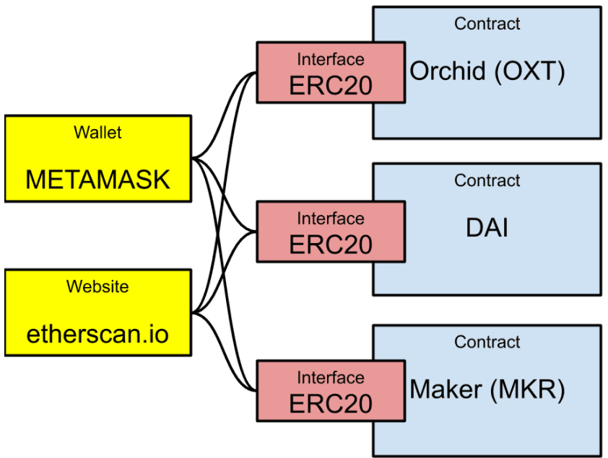
Token Standards

Slide 13
ERC-20
The ERC-20 (Ethereum Request for Comments 20), proposed by Fabian Vogelsteller in November 2015, is a Token Standard that implements an API for tokens within Smart Contracts.
An ERC20 token contract keeps track of fungible tokens: any one token is exactly equal to any other token; no tokens have special rights or behavior associated with them.
This makes ERC20 tokens useful for things like a medium of exchange currency, voting rights, staking, and more.
https://eips.ethereum.org/EIPS/eip-20

Slide 14
ERC-20
ERC-20 has emerged as the technical standard; it is used for all smart contracts on the Ethereum blockchain for token implementation and provides a list of rules that all Ethereum-based tokens must follow.
The standard describes the interface of the smart contracts.
Consider the ERC-20 standard as a set of rules: In order for a token to be created and transacted on the Ethereum network, it must follow these rules.

Slide 15
ERC-20
It provides functionalities like to transfer tokens from one account to another, to get the current token balance of an account and also the total supply of the token available on the network.
Besides these it also has some other functionalities like to approve that an amount of token from an account can be spent by a third party account.
If a Smart Contract implements the following methods and events it can be called an ERC-20 Token Contract and, once deployed, it will be responsible to keep track of the created tokens on Ethereum

Slide 16
Token Contract
A token contract is simply an Ethereum smart contract. "Sending tokens" actually means "calling a method on a smart contract that someone wrote and deployed".
A token contract is not much more a mapping of addresses to balances, plus some methods to add and subtract from those balances.
It is these balances that represent the tokens themselves. Someone "has tokens" when their balance in the token contract is non-zero.
These balances could be considered money, experience points in a game, deeds of ownership, or voting rights, and each of these tokens would be stored in different token contracts.

Slide 17
Token Contract
A token contract is a smart contract that contains a map of account addresses and their balances.
The balance represents a value that is defined by the contract creator:
one token contract might use balances to represent physical objects, another monetary value, and a third the holder’s reputation.
The unit of this balance is commonly called a token.

Slide 18
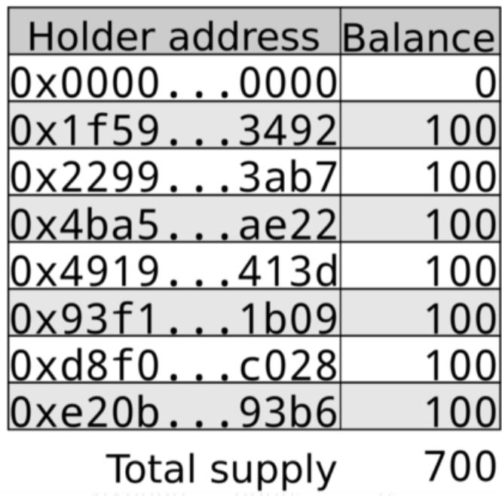
Token Contract
map of account addresses and their balances.
https://medium.com/@jgm.orinoco/understanding-erc-20-token-contracts-a809a7310aa5

Slide 19
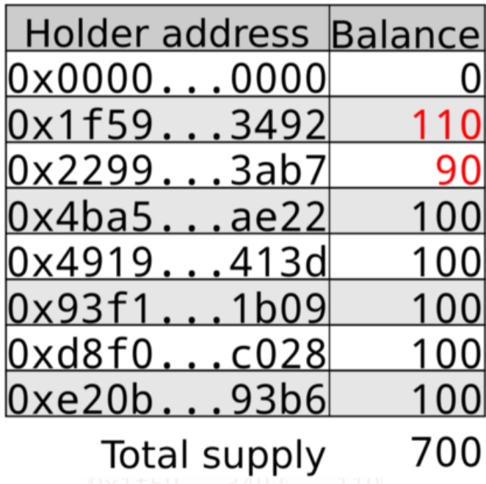
Token Contract
transfer of 10 tokens from 0x2299…3ab7 to 0x1f59…3492

Slide 20
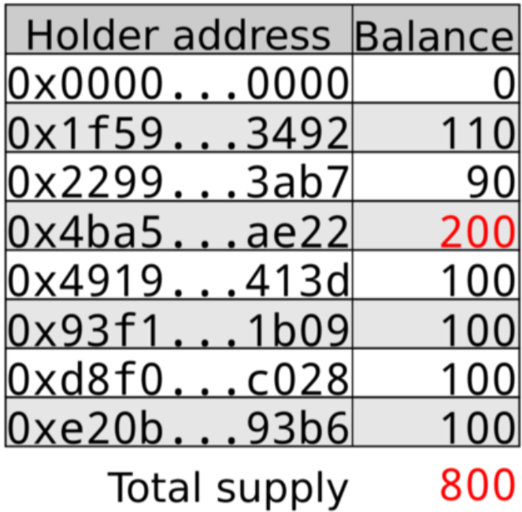
Token Contract
minting 100 tokens to 0x4ba5…ae22

Slide 21
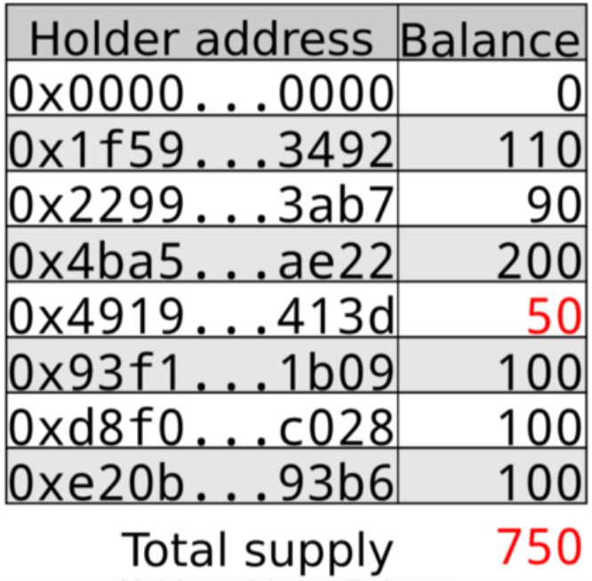
Token Contract
The total supply of tokens can be decreased by burning existing tokens. For example, 0x4919…413d burning 50 tokens would result in the balances being updated

Slide 22
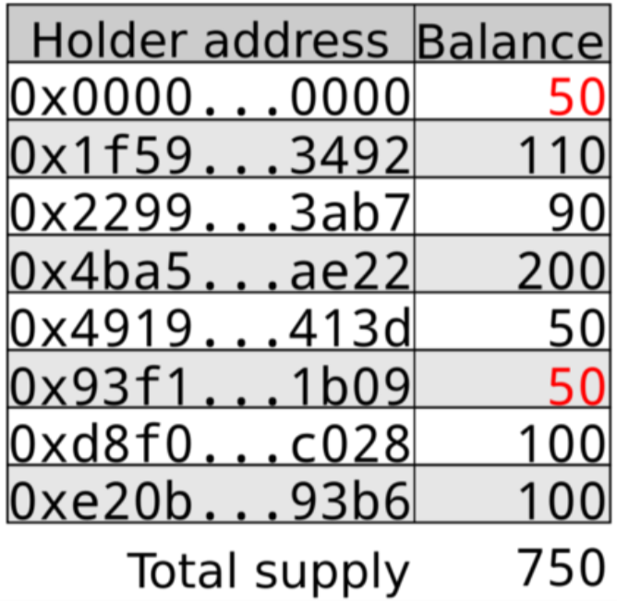
Token Contract
An alternative method of burning tokens is to send the tokens to an address to which the private key is not known, commonly the 0 address. This has the same effect as burning tokens in terms of making the tokens unavailable to spend, but does not decrease the total number of tokens

Slide 23
ERC-20
ERC20 tokens are simply a subset of Ethereum tokens.
In order to be fully ERC20 compliant the developer needs to incorporate a specific set of functions into their smart contract that at a high level will allow it to perform the following actions:
get the total token supply
get the account balance
transfer the token
approve spending the token
ERC20 allows for seamless interaction with other smart contracts and decentralized applications on the Ethereum blockchain.

Slide 24
ERC-20
The ERC20 standard consists of 3 optional rules and 6 mandatory rules.
The mandatory functions required are as follows:
totalSupply
balanceOf
transfer
transferFrom
approve
allowance
On the other hand, the optional rules are:
Token Name
Symbol
Decimal (up to https://18)
blockgeeks.com/guides/erc20-tokens/

Slide 25
ERC-20
The token name and symbol is declared like this:
string public constant name = “Token Name”;
string public constant symbol = “SYM”;
Smallest number of decimals. 0 will mean that the lowest value of the token is 1. A divisibility of 2, on the other hand, means its lowest value will be 0.01. The maximum number of decimal places allowed is 18. It is declared like this:
uint8 public constant decimals = 18;
https://github.com/OpenZeppelin/openzeppelin-contracts/blob/9b3710465583284b8c4c5d2245749246bb2e0094/contracts/token/ERC20/ERC20.sol

Slide 26
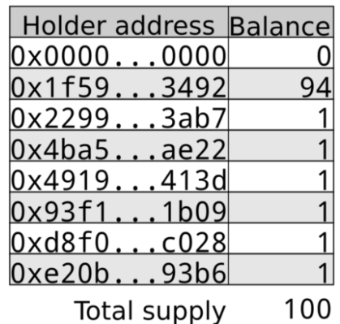
ERC-20: decimals
decimals refers to how divisible a token can be, from 0 (not at all divisible) to 18 (pretty much continuous) and even higher if required.
The reason that decimals exists is that Ethereum does not deal with decimal numbers, representing all numeric values as integers.
If the token represents something like a software license, then it makes no sense for it to have a decimal place since you can’t have a fractional license. So the decimals should be set to 0.

Slide 27
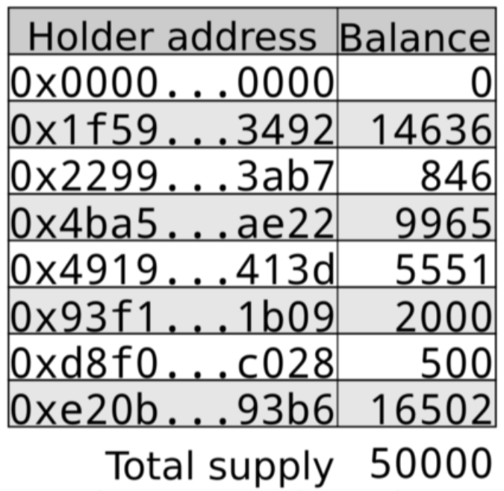
ERC-20: decimals
Say, the token represents ownership of gold.
The token creator wants the unit of to represent 1 kilogram of gold, but also wants to allow users to hold and trade amounts of gold down to the gram level (but no lower).
Then decimals are set to 3 (as there are 10³ grams in the kilogram of gold that the token creator wishes to be displayed as 1 token).
a total of 50Kg of gold represented

Slide 28
ERC-20: decimals
Does the token contract represent an indivisible entity? Then set decimals to 0
Does the token contract represent an item with a fixed number of decimal places? Then set decimals to that number.
If neither of the above apply set decimals to 18.
The number of tokens that should be created is equal to the whole number of tokens that are required multiplied by 10^decimals.
As can be seen with the GoldToken example, the token creator wanted to create tokens representing 50Kg of gold but to do so with 3 decimals they must mint 50,000 tokens (50 * 10³).

Slide 29
ERC-20
totalSupply
totalSupply identifies the total number of ERC-20 tokens created. The purpose of this method is to determine the total number of tokens floating around the ecosystem. You create all at once, or slowly mint them. No mining is required.
balanceOf
The balanceOf function returns the number of tokens that a particular address has in the account.

Slide 30
ERC-20
transfer()
Moves amount tokens from the caller’s account to recipient.

Slide 31
ERC-20
approve()
Approve gives another account (could be smart contract) approval to transfer up to a certain number of tokens, known as an allowance, on behalf of token owner

Slide 32
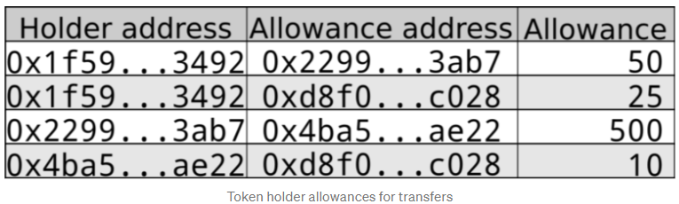
ERC-20: Approve and Allowance
In the above example the second line shows that Joe with address 0x1f59…3492 has allowed the contract at 0xd8f0…c028 to transfer up to 25 tokens from Joe’s account

Slide 33
ERC-20
allowance()
The allowance() function returns the number of tokens allowed to be transferred from a given address _from by another given address _to on behalf of _from through transferFrom()

Slide 34
ERC-20
transferFrom()
It allows a delegate approved for withdrawal to transfer owner funds to a third-party account.

Slide 35
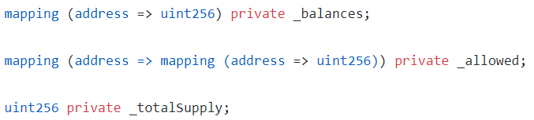
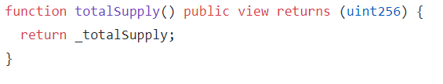

Solidity ERC-20

Slide 36
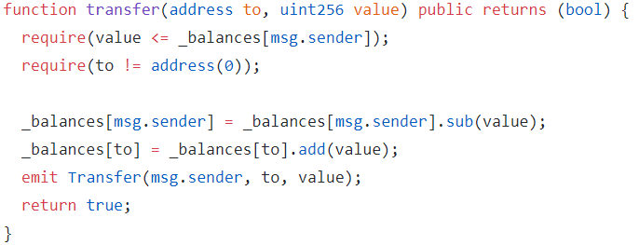
Solidity ERC-20: transfer
to The address to transfer to.
value The amount to be transferred

Slide 37
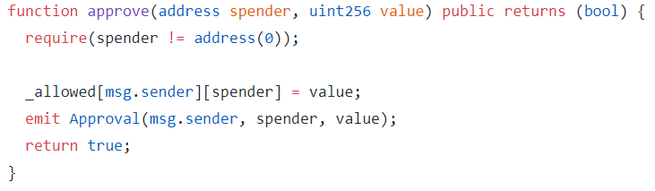
Solidity ERC-20: Approve
What approve does is to allow an owner i.e. msg.sender to approve a delegate account (spender) — possibly the marketplace itself — to withdraw tokens from his account and to transfer them to other accounts.
https://github.com/OpenZeppelin/openzeppelin-contracts

Slide 38
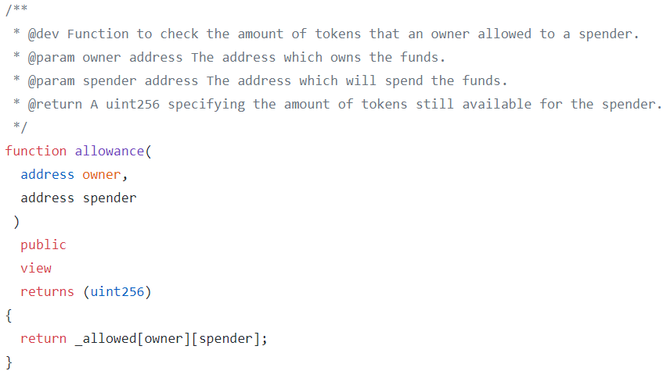
Solidity ERC-20: Allowance

Slide 39
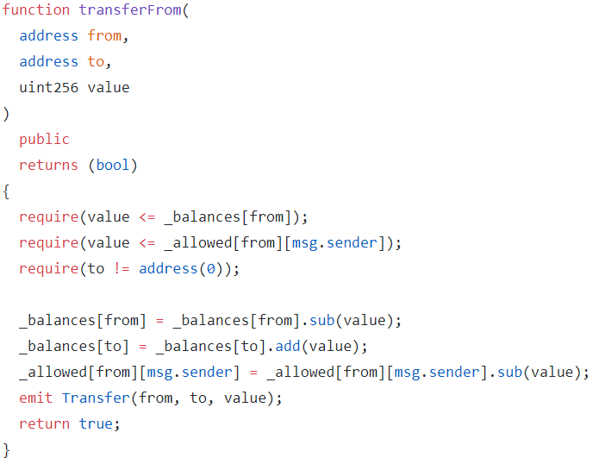
Solidity ERC-20: transferFrom
from address The address which you want to send tokens from
to address The address which you want to transfer to

Slide 40
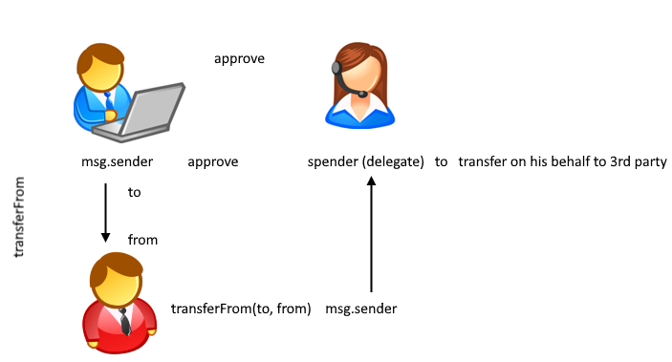
Solidity ERC-20: transferFrom

Slide 41
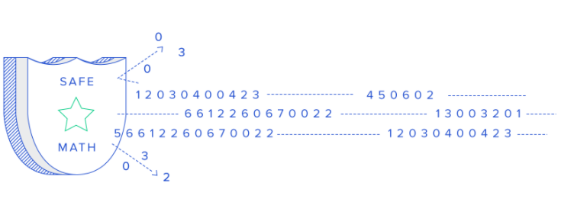
Safe Maths
SafeMath are wrappers over Solidity’s arithmetic operations with added overflow checks.
SafeMath protects against this by testing for overflow before performing the arithmetic action, thus removing the danger of overflow attack
However, Solidity 0.8 marks the end of the SafeMath era, as overflow checks are now built into the compiler.

